Slide 1

OPERATING SYSTEM
LAB ASSIGNMENT - 2
cut command implementation in C snippets and explanations
GROUP MEMBERS:
1.Mitta Lekhana Reddy - IIT2019204
2.Sanskar Patro - IIT2019205
3.Dhanush Vasa - IIT2019208
4.Gitika Yadav - IIT2019219
5.Pravallika Kodi - IIT2019234

Slide 2
Question 1F provided to us :
Create your own SHELL-commands to simulate (mimic) the functionality of the well-known SHELL commands:-
mycut [-d] "delimiter" [-f] field-number filename

Slide 3
FUNCTIONS USED IN THE CODE
int main (int argc , char* argv[ ])
void markFields(char fields[ ])
void checkFields(char s[ ] )
void Error( )
void parseCommandLine(int argc , char* argv[ ])
void cutFile( )

Slide 4
Variables and their usage in code
char *fileName;
char delim = '\t'; delimiter is set by default as tab
bool fGiven = 0; checks if fields are given or not
bool validField[1001] = {false}; array in which we mark all the given fields as true
int fieldsIdx fieldsIdx - stores index of fields in arg vector
int delimIdx delimIdx - stores index of delimiter in arg vector
int highestField = 0; highestField - stores value of highest field input by the user.

Slide 5
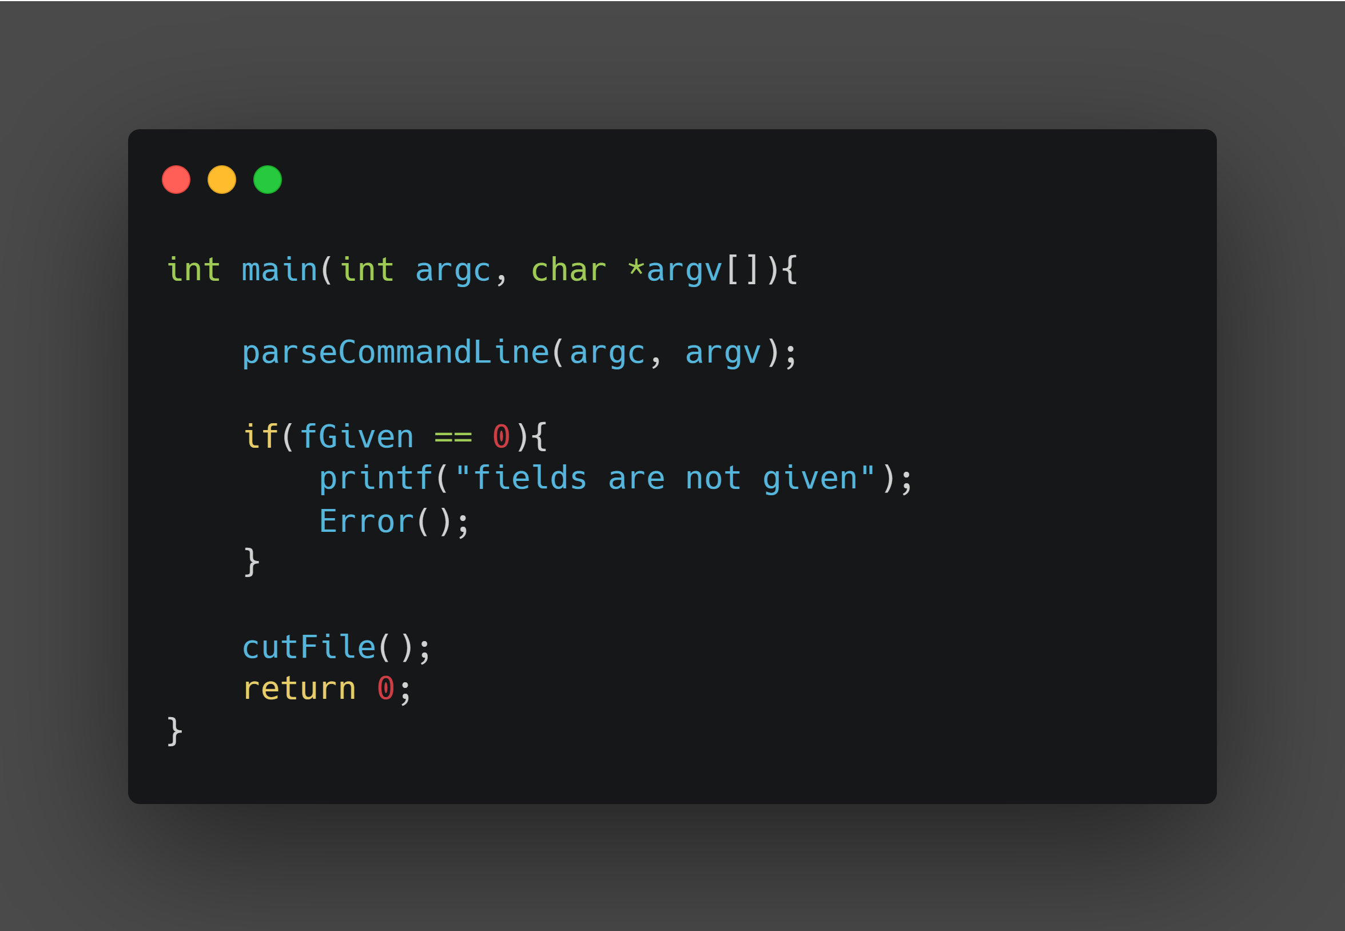

Slide 6
Explanation of main:
^In the above main function argc stands for argument count and argv stands for argument vector. These are variables passed from command line to the main function when it starts executing. They are command-line arguments.
^Later, parseCommandLine (slide 17) function is called by the main function.
^If the variable fGiven = 0 then we exit along with the message “ fields are not given “ and exits from the code.
Else the function cutFile() is called by the callee .
^And finally after execution of cutFile() the main exits, returns 0

Slide 7
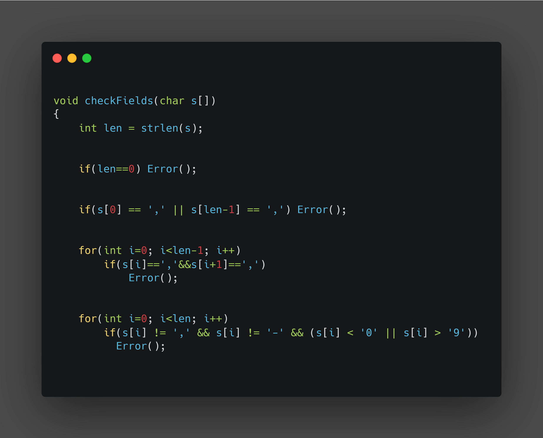
checkFields function

Slide 8
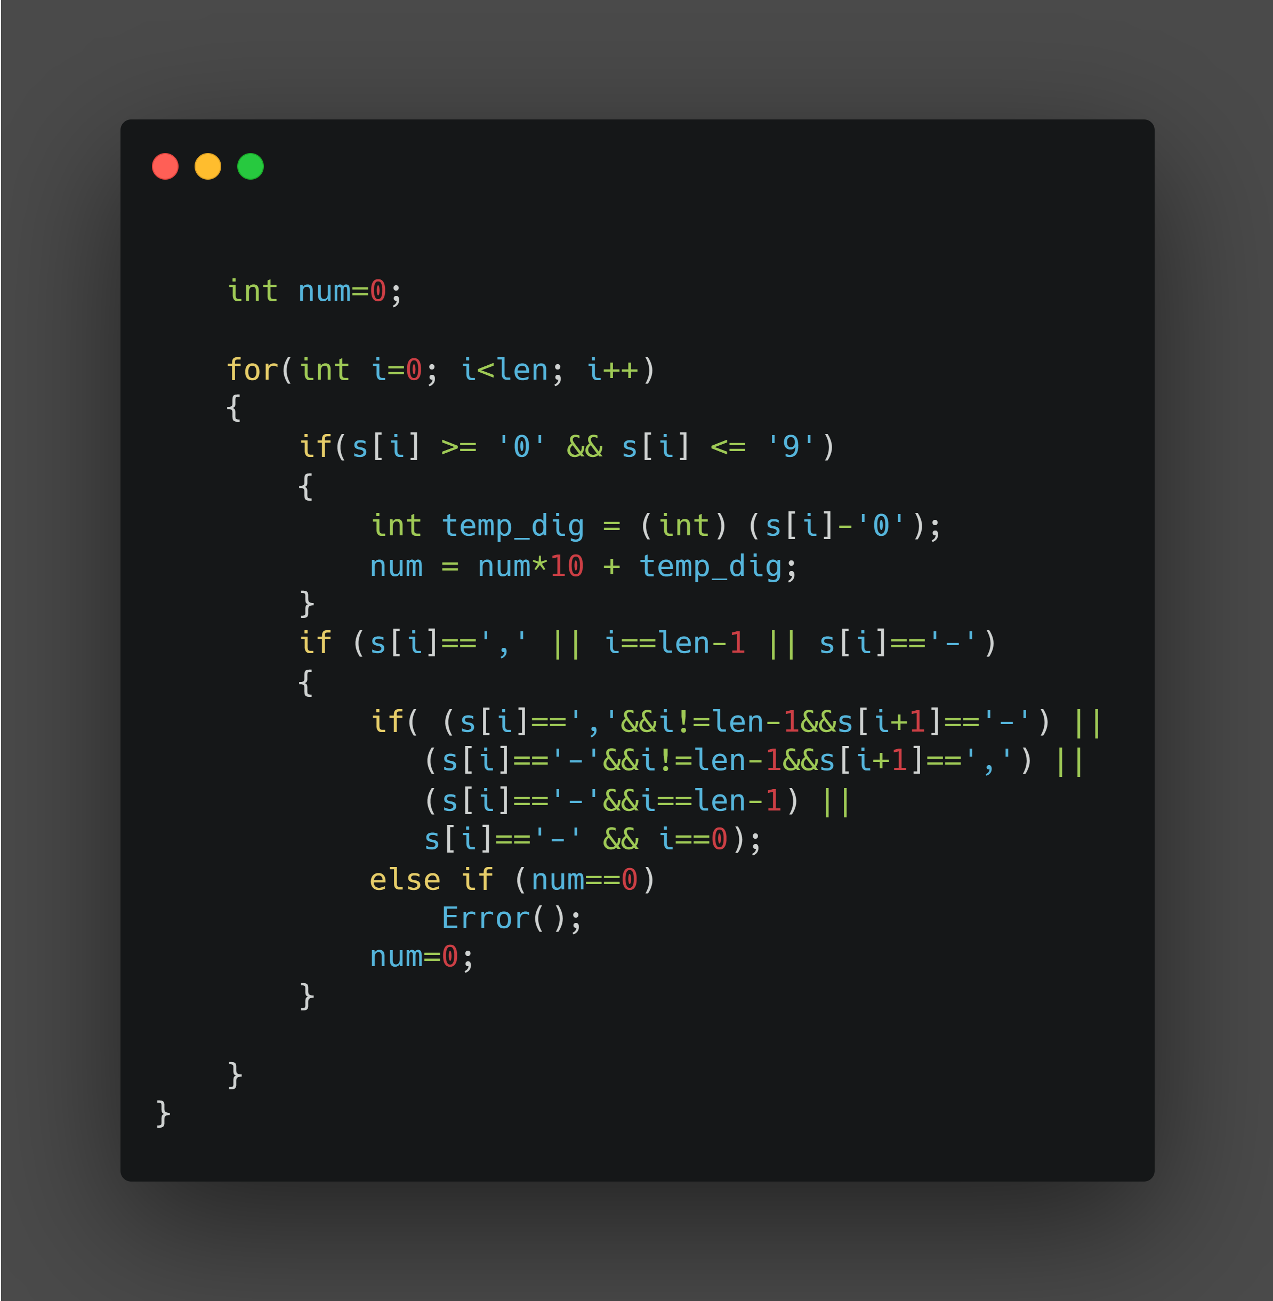
checkFields function continuation

Slide 9
Explanation for slides 8 - 9
CheckFields (chars[]) : a void function checkFields with argument chars[] i.e., char array of fields is called. Basically this function checks whether the user input fields are acceptable or not. If the user input field is not acceptable then displays error.
-Get the length of char array using strlen() function available from <string.h> library.
-If length of the char array of fields is zero then Error() function is called which displays the message “ there is error “
-If the first or len-1 element of the field char array is “,” then Error function is called .

Slide 10
Explanation for slides 8 - 9
-If either first or last elements of field char array is “,” then error function is called.
-Ex: “,2” ; “ 3,
“ ; “1,,2” =>in these cases Error() is called.
-If the field char array contains elements other than “,” , “-” and digits from 0 to 9 then again error function will be called
-An int variable “num” is initialised to zero.
- then while traversing through each and every element of field char array
- * if current element of array is digit (0-9) then we have to get the integer values of that digit and store in int variable num.

Slide 11
Explanation for slides 8 - 9
-If element of field char array is “,” or “-” or the index of the current element is (len-1) and
-if current element of field char array is “,” and the next element of field char array is “-” and current element’s index is not equal to (len-1) or
if current element of field char array is “-” and the next element of field char array is “,” and current element’s index is not equal to (len-1) or
if current element of field char array is “-” and current element’s index is equal to (len-1)
if current element of field char array is “-” and current element’s index is equal to zero.Then the field is accepted.
Elseif num=0 then error function is called.
In the end, value of num is re-initialized to 0.

Slide 12
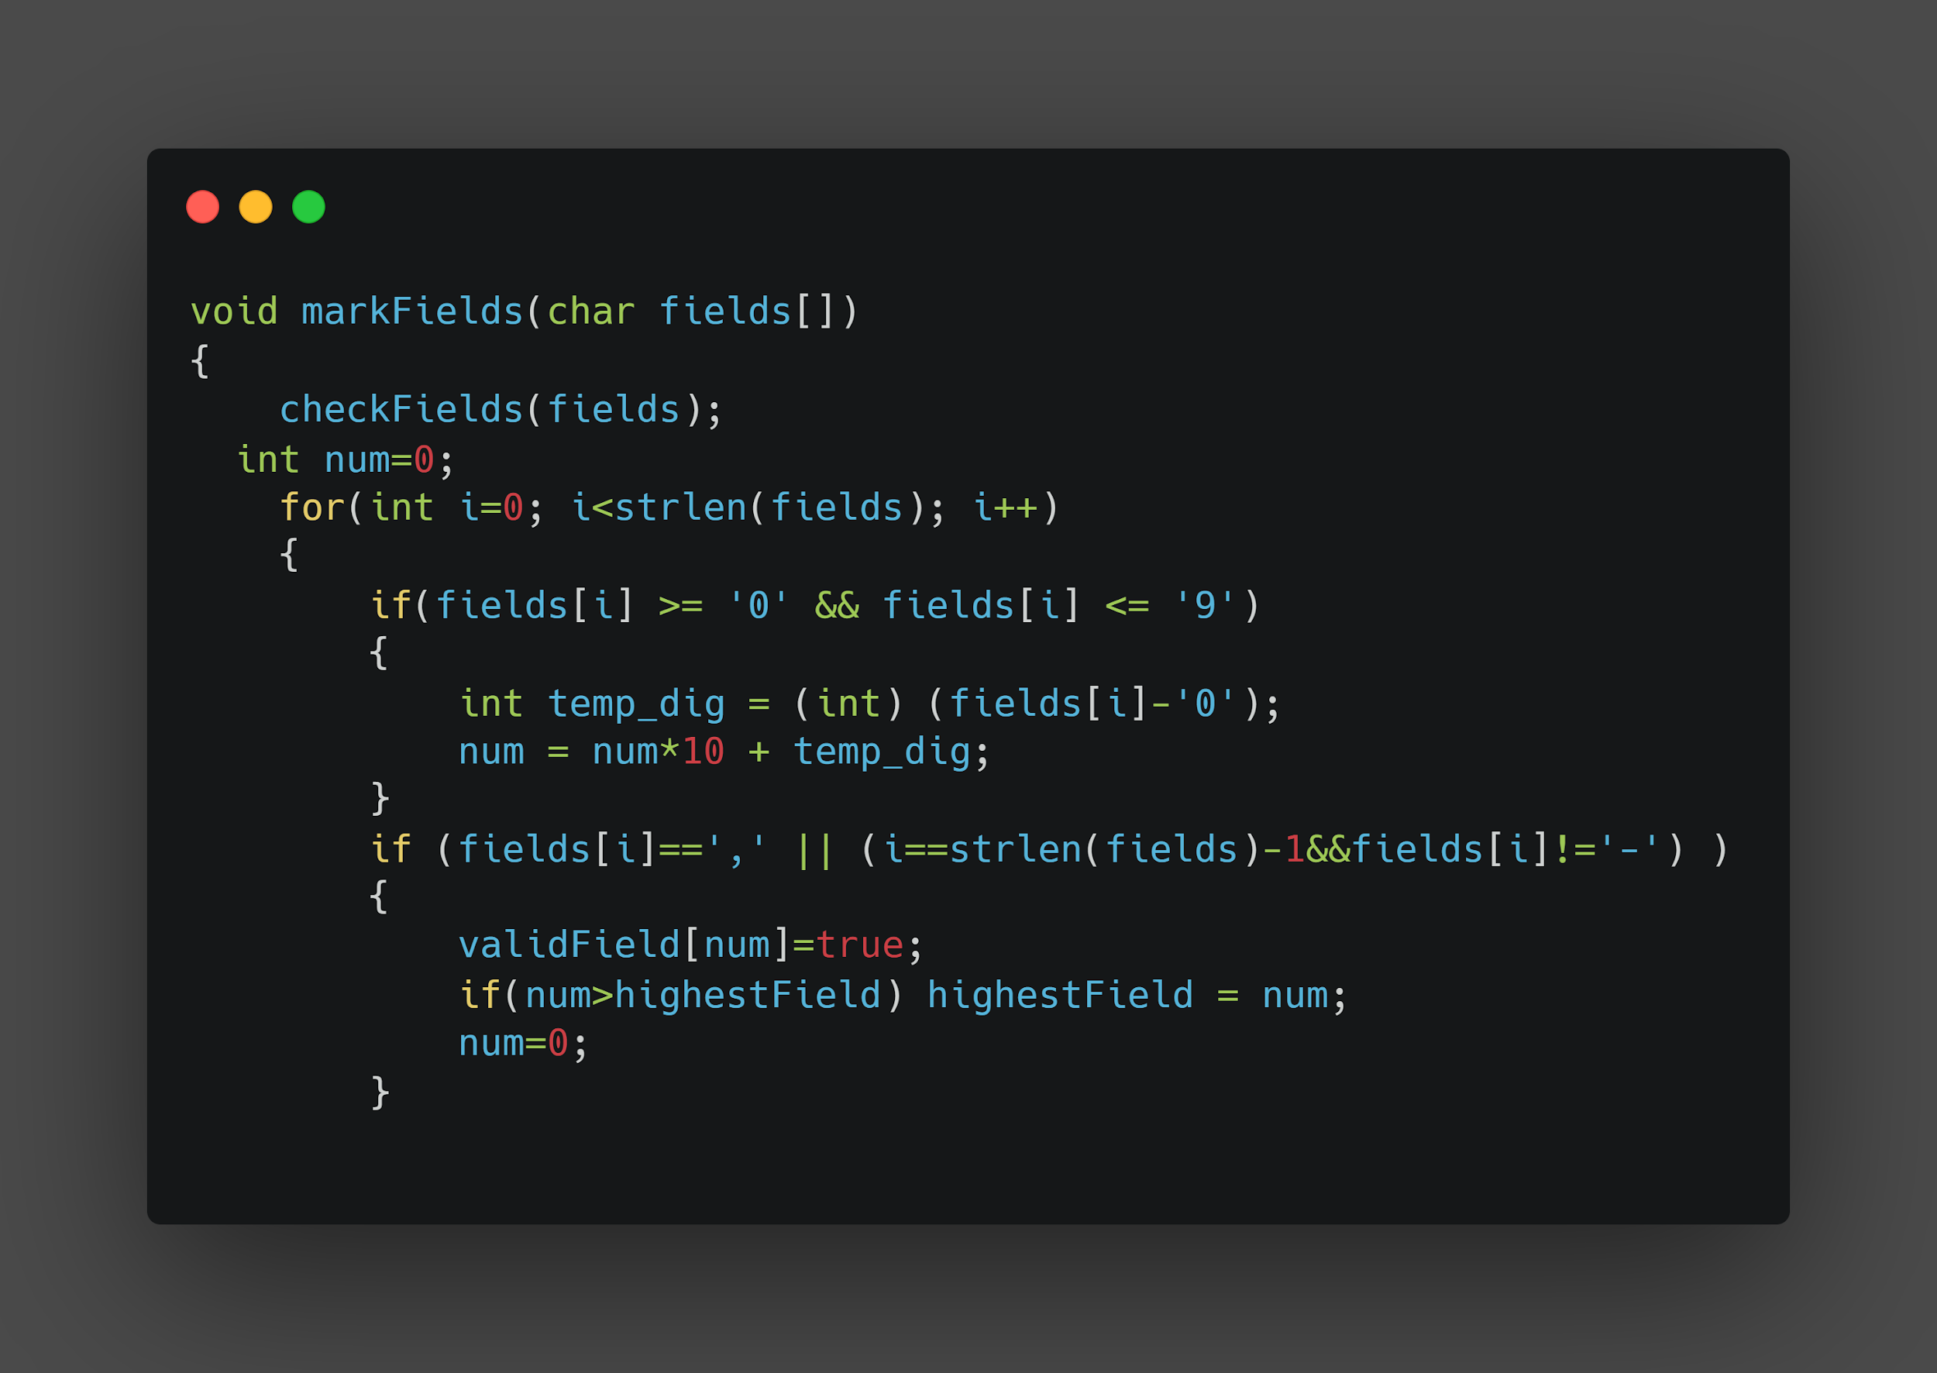
markFields function

Slide 13
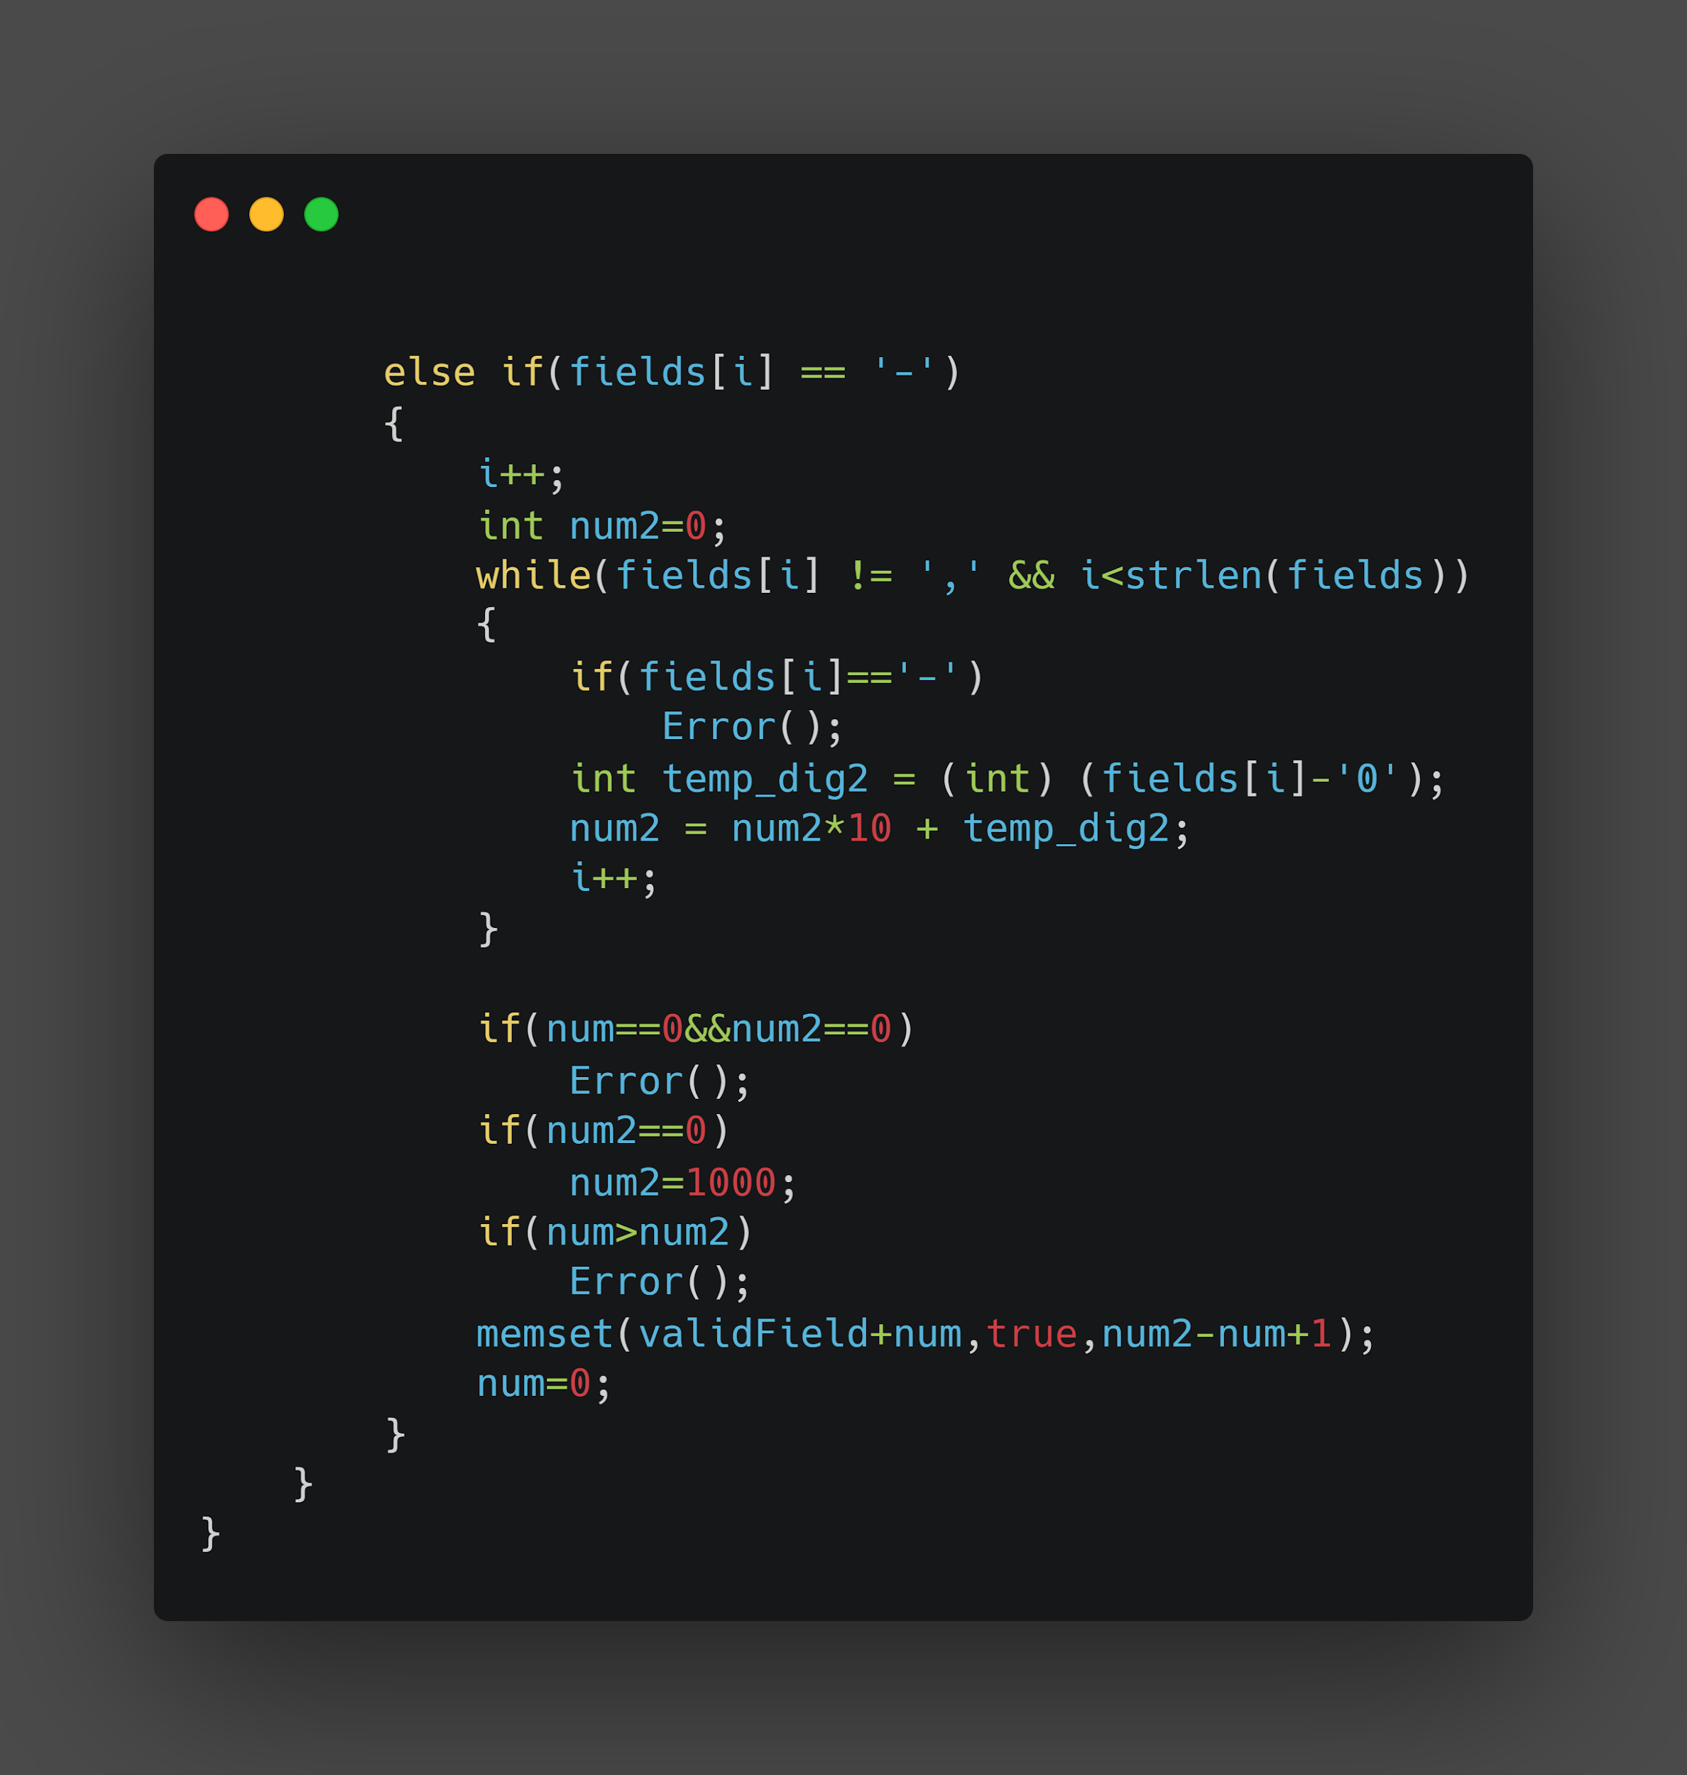
markFields function continuation

Slide 14
Explanation for slides 12 - 13:
When the function markFields with argument char fields[ ] i.e., range of fields of delimiter is called:
- Firstly, checkFields function is called to check whether the field is accepted or not .
If field is not acceptable then error will be displayed.
Now,let’s initialize the int variable num to 0
While traversing through each and every element of field char array ,if current element of field char array is a digit (from 0 to 9) then we have to get integer value of that element and which to be stored in variable num.
-If the current element of field char array is “,” or current element’s index is strlen(fields)-1 and current element of field char array is “-” then the bool array index num of valid Field which initialized to False is to be updated to True.

Slide 15
Explanation for slides 12 - 13:
-if the int variable num is greater than highestField then highestField = num and then num is re-initialized to 0.
-else if the current element of field char array is “-” then current element’s index is updated by 1 and initializes int variable num2=0
While the current element of field char is not “,” and current element index is less than strlen(fields) follows if current element of field char is “-” then Error() is called and num2 is assigned to the value of digits.
-if both num and num2 equals to 0 then Error() is called ,but if num2=0 then num is updated to 1000
-if num>num2 then Error() is called else memset function is called and re-initialize int variable num to 0.

Slide 16
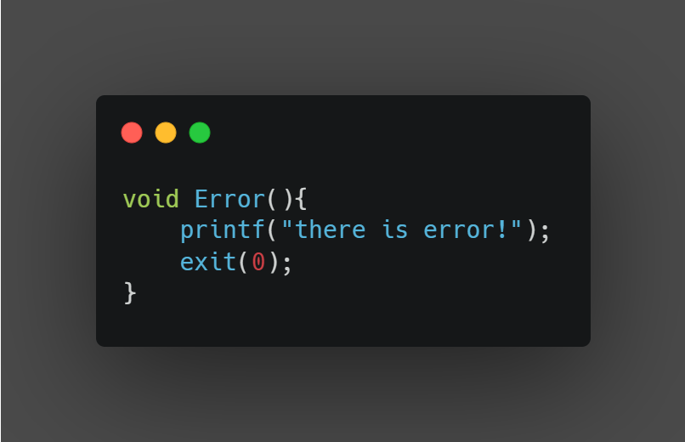
Error function

Slide 17
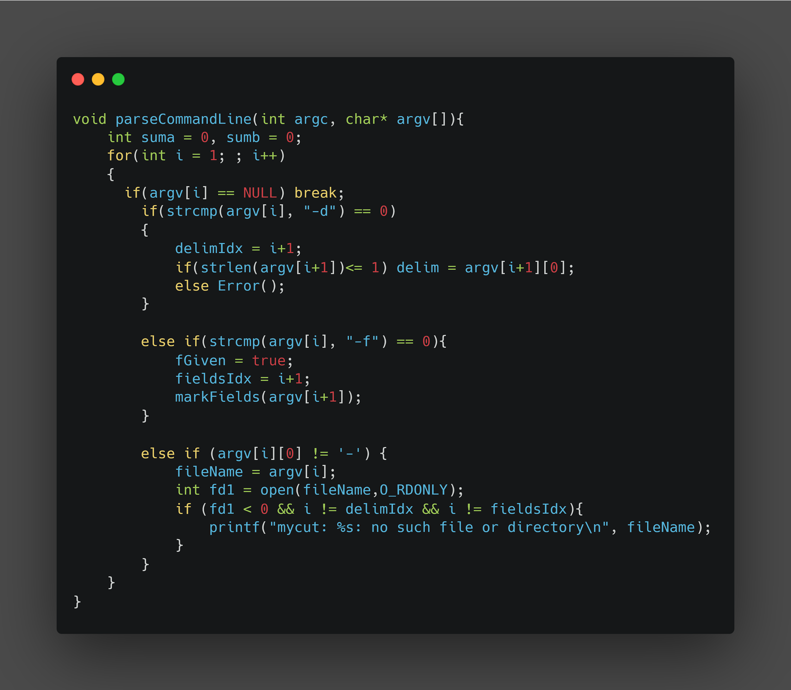
parseCommandline function:

Slide 18
Explanation for slide 17:
The parseCommandLine function with arguments argc and argv[ ]
We run an infinite loop through the argument vector:
-if argument variable is equal to NULL ,then the loop breaks.
-if argument variable is equal to string “-d” and if the length of next argument variable is less than or equal to 1, then the char variable delim is equal to first element int the next argument variable ,else Error() is called.
-else if argument variable is equal to string “-f” then fGiven is initialised to True and markFields function with next argument variable is called.
-else if first element of argument variable is not equal to “-” ,then fileName gets initialized to that argument variable . We check if the file does not exist, and if it doesn’t , then displays message “ mycut : filename : no such file or directory ”

Slide 19
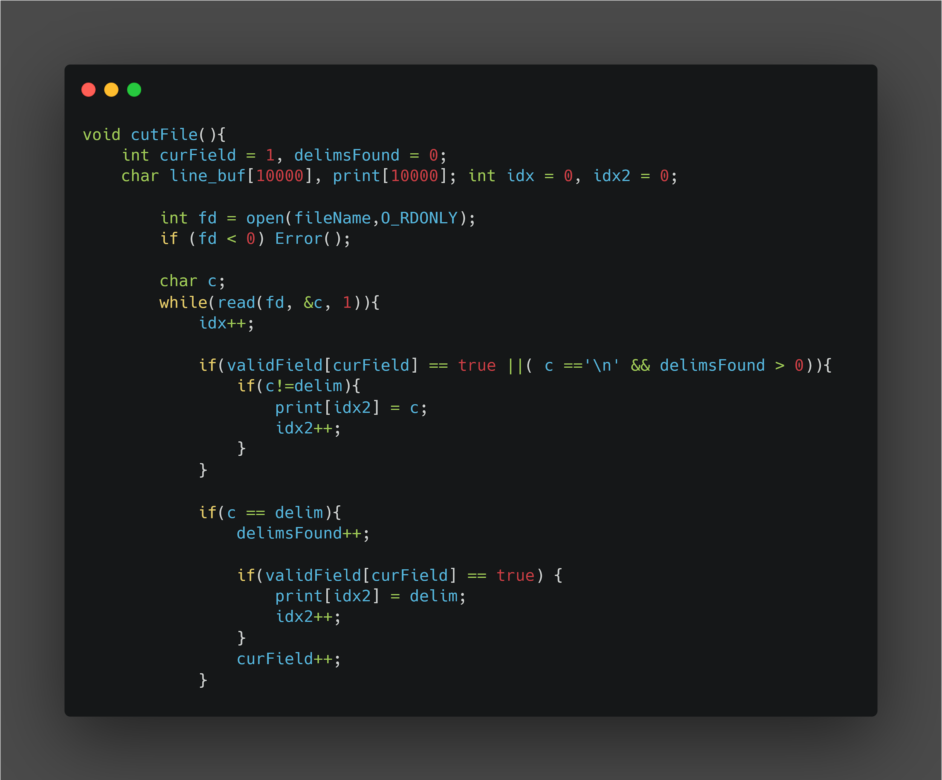
cutFile function: part A

Slide 20
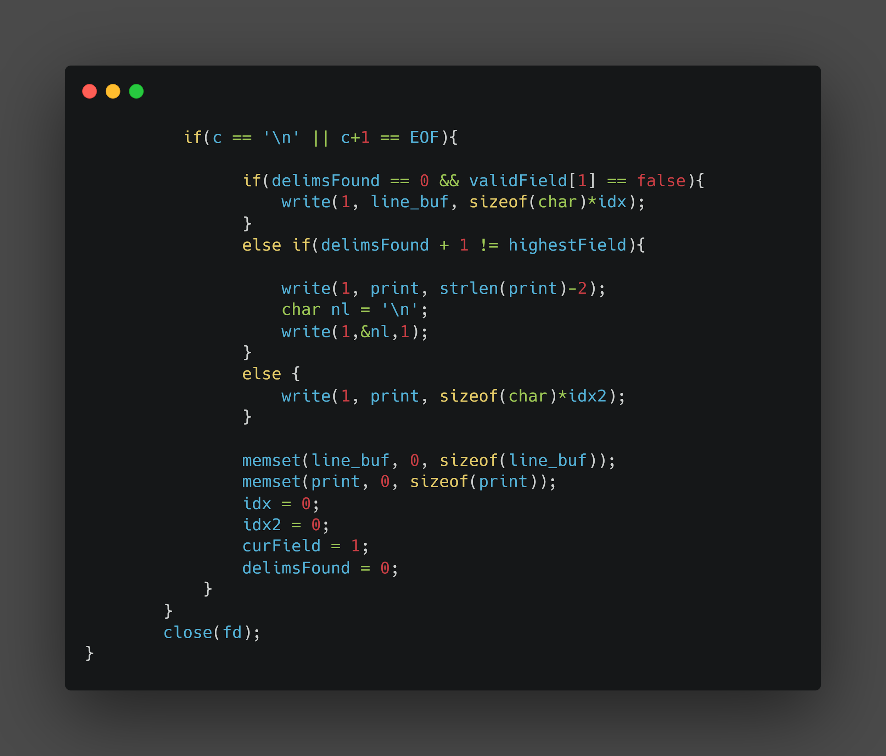
cutFile function: part B

Slide 21
Explanation for slides 19 - 20:
-cutFile() actually writes output to command line.In the cutFile, we first initialize curField, which says about the current field we are in to 1, and another int variable delimsFound, which counts number of delimiters found to zero.
-Now we initialise line_buf array and print array of array size 1000 and then we initialise two indices for both arrays, named idx and idx2 respectively to 0.We now use file descriptor fd where open function, which open file filename is assigned to it. If fd is less than 0,it means file doesn’t exist ,so it calls Error().
-Now we declare char c, then we execute while loop,where we read file contents character by character until we reach EOF(end of file). Here in the loop each character is stored in line_buf array. Next we use nested if condition, where outer condtion is to check if the current field is a valid field or if the

Slide 22
Explanation for slides 19 - 20:
character is a new line and the inner condition is to check if current character is not the delimiter,if it is satisfied then the character is stored in print buffer array.
-We use another nested if condition, where outer condition is to check if the current character is delimiter and inner loop is to check if the current field is valid, if it is true then delim is stored in print buffer array
-Another nested if condition is created,where outer loop is to check if current character is new line or next character is EOF(end of file).
- if no delims have been found in this line,we print entire line_buf array to command line.
-else if number of delims found is one less than the highest field specified by user, then print entire print array except last two elements and print new line.

Slide 23
Explanation for slides 19 - 20:
-else if we have found at least one delimiter and number of delims found is not 1 less than the highest field specified by user.
-After these conditions we use memset function to reset line_buf array and also to reset print array
-Now we reset idx and idx2 to 0 and curField to 1 and delimsFound to 0
-And lastly we close the file.

Slide 24
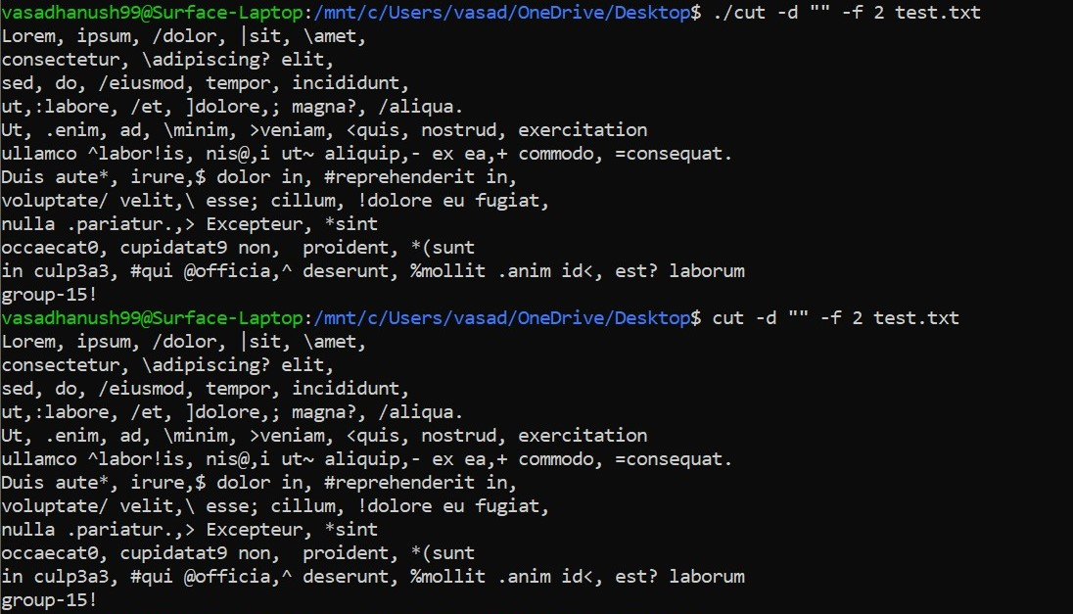
Example - 1
(Since delimiter is empty, nothing is cut from the file)

Slide 25
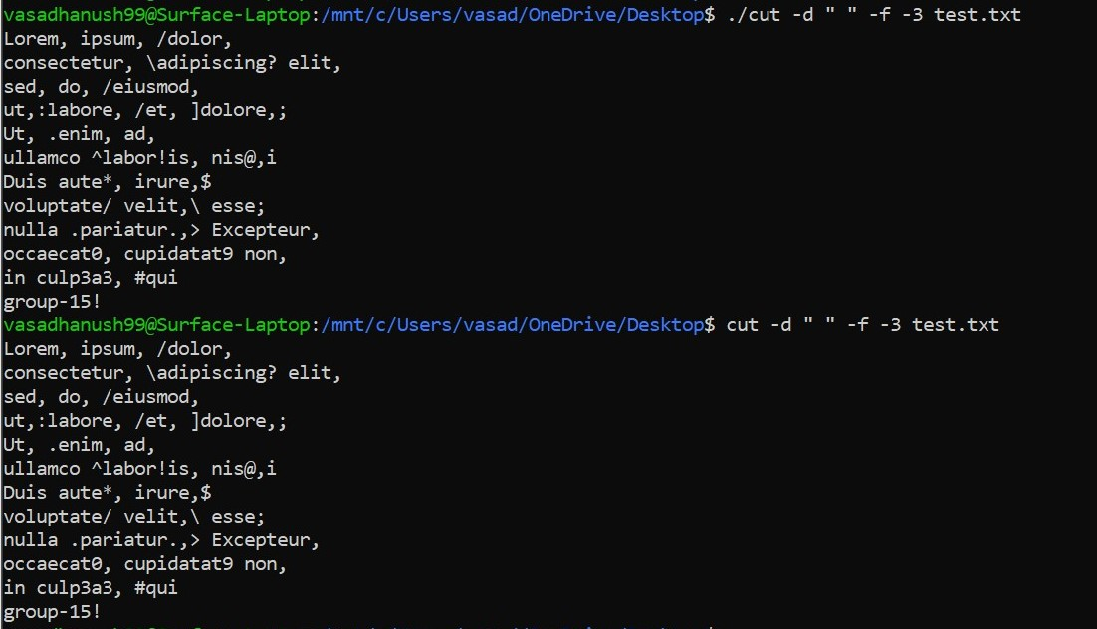
Example - 2

Slide 26
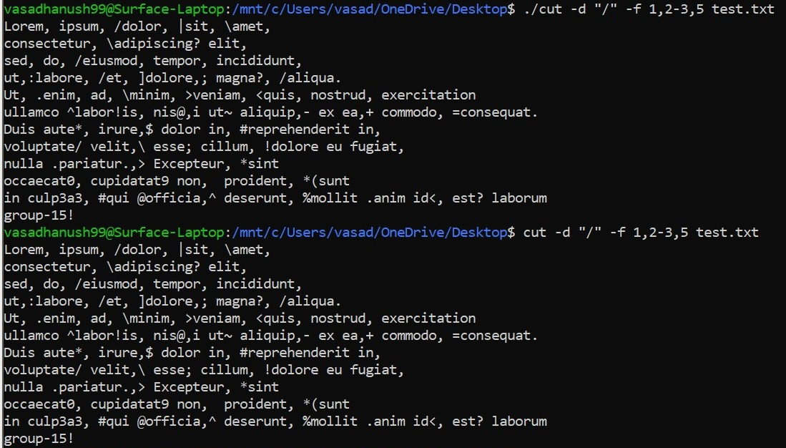
Example - 3

Slide 27
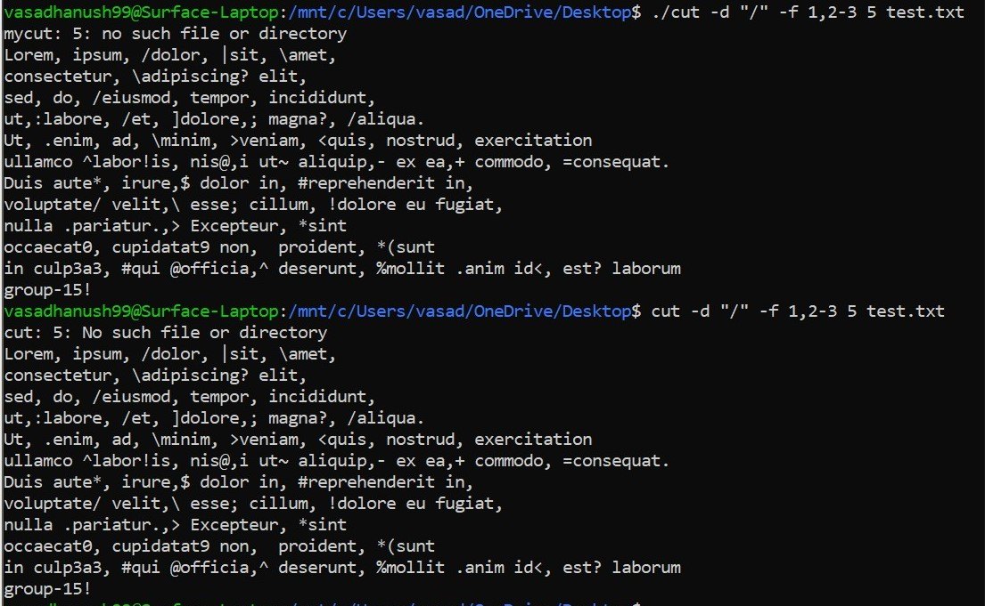
Example - 4

Slide 28
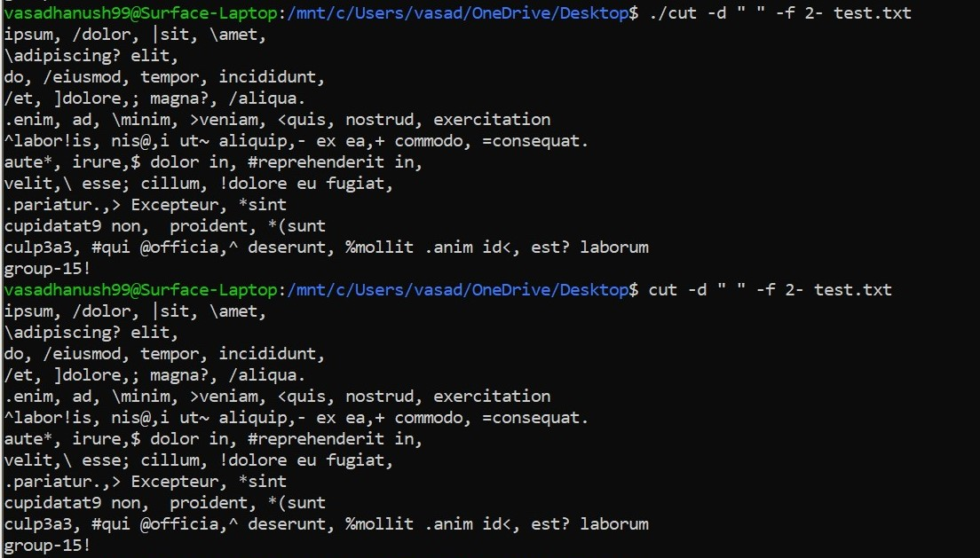
Example - 5

Slide 29
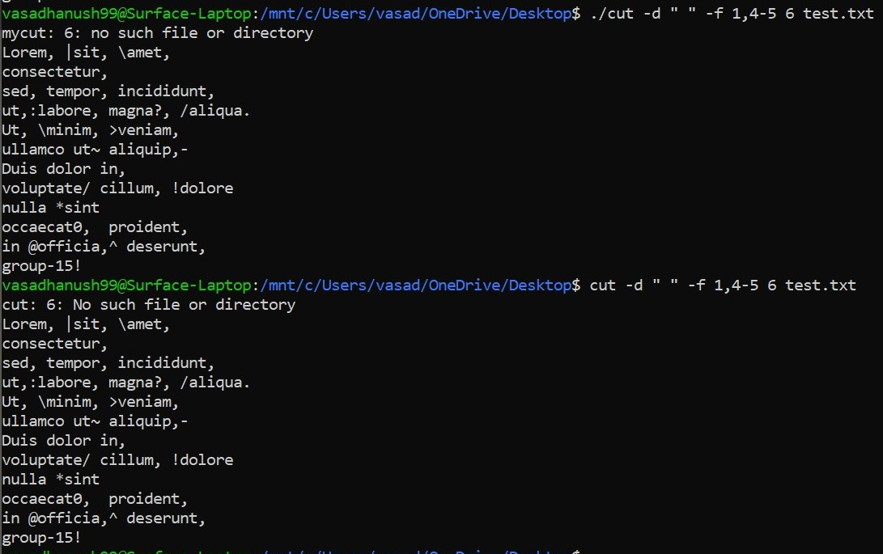
Example - 6

Slide 30
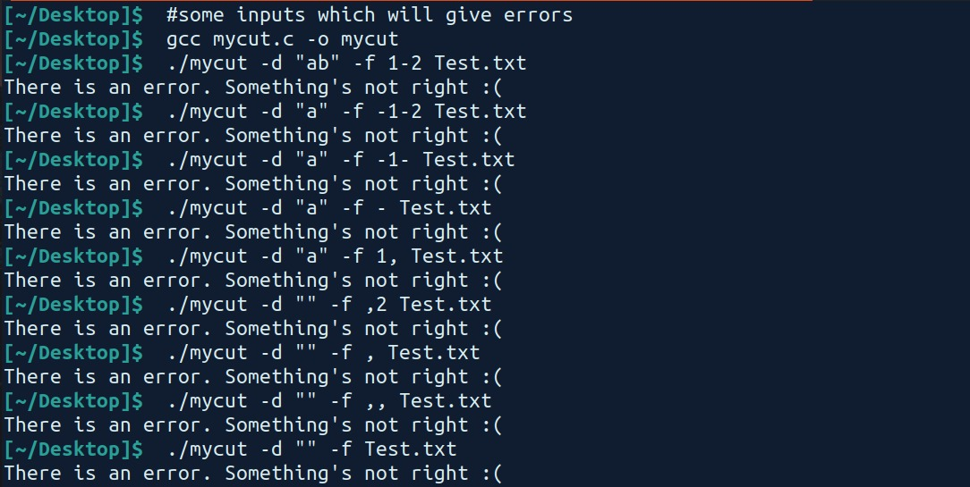
Example - 7 - some error cases

Slide 31
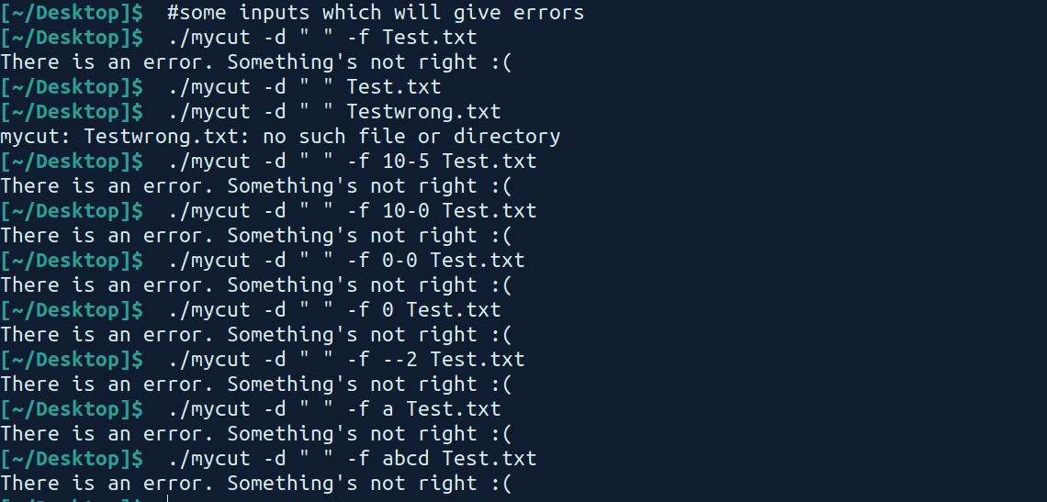
Example - 8 - some error cases

